Slide 1
Architecture of Database

Slide 2
Architecture of Database
There are three levels or layer of DBMS Architecture:
1. External Level or View Level
2.Conceptual Level or Logical Level
3.Internal Level or Physical Level

Slide 3
External Level: It is User’s view of the database. This level describes that part of the database that is relevant to each user. Therefore same database can have different view for different users.
  For Example: For student database, the account department may concerned with the student name, student id and fee receipt whereas the library department may be concerned with student name, student id and the books issued.

Slide 4
Conceptual Level or Logical Level:
This level describes what data is stored in the database and what is the relationship among the data. This level represents :
All Entities, their attributes and their relationship.
Internal level : This is the physical representation of the database on the computer. This level describes how the data is stored.

Slide 5
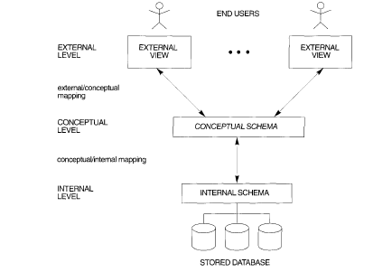

Slide 6
Schema and Instances
The Schema is plan or the scheme of the database. This consists of :
  Type of the entities
  Relationship among the entities.
  The way in which entities and relationship are expressed.
  There are two type of schemas:
  -- Physical Schema which describes the database at physical level.
  -- Logical Schema which describes the database at logical level.

Slide 7
  Instances : AS new information is inserted or deleted in a database it changes with time. The collection of data stored at particular instant of time is known as Instance of database .The data stored in the database at A particular moment of time is known as the instance of the database.

Slide 8
Database States
Empty State : When we define a New database with no data.
Initial State: when the Database is first populated or loaded with the initial data.
Current state: when some updation is Performed in database .The database is known to be as in current state.
Valid State: When structure and Constraints on the schema are consistent

Slide 9
Data Independence
The major objective for three-level architecture is to provide data independence which means that upper level are unaffected by changes in the lower level.
The ability to modify a scheme definition in one level without affecting a schema definition in the next higher level is called a data independence.
  Two type of data independence
    Logical Data Independence.
    Physical Data Independence.

Slide 10
Logical Data Independence
Logical Data Independence : Is basically ability to change the conceptual schema without altering the external schema. For example addition or removal of new entities, attributes or relationships should be possible without having to change existing external schema or having rewrite application programs.

Slide 11
Physical Data Independence
Physical Data Independence :It is ability to change in the internal schema without affecting the conceptual schema .
It means that physical layout and organization of data may be changed without changing either overall logical structure of data or the application program.

Slide 12
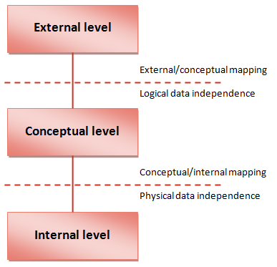
Data Independence And Three Level Architecture

Slide 13
DBMS Interfaces
Menu Based Interfaces for Web Clients Or Browsing: This interfaces Present the user with lists of options . Query is composed step by step picking up options from a menu that is displayed by the system . No need to memorize the specific commands and syntax of a query languages. Ex: PHPMYADMIN In Xampp
Forms Based Interfaces: A Form Based interface displays a form to each user .user fill out all of the form entries to insert new data , or they can fill out only certain Entries in that case DBMS will retrieve the other entries matching those entries .Example : hotel management system

Slide 14
Graphical User Interfaces: A GUI interface displays a schema to the user in diagrammatic form. The user can specify the query by manipulating the diagram. Example : Microsoft Access
Natural Language Interfaces: These interfaces accept requests written in English or some other language and attempt to understand them. Retrieve the results based on them For Example : Google.

Slide 15
Interfaces for Parametric Users: Parametric users such as bank teller , often have a small set of operations that they must perform repeatedly.
Interface for a DBA: Most database systems Contain Privileged Commands that Can be used only by the DBA Staff.

Slide 16
Database languages
DDL ( Data Definition Languages) : It is basically used by DBA and designer to define the schema.
DML( Data Manipulation Languages): It is basically used to manipulate or update the database schema. They include Retrieval ,insertion ,deleting , and modification of data done by the end users.

Slide 17
Data Management System
Classification Criteria
1Based on Data Model
  1.1Relational Database
  1.2Object Oriented database
  2 Based on User
  2.1Single User
  2.2Multiple User

Slide 18
3 Based on number of Sites
  3.1 Centralised DBMS
  3.2 Distributed DBMS

